Slide 1
ADHD and Families
MICAMH Conference Feb, 2018
Charlotte Johnston

Slide 2
Presenter Disclosure:
Research funded by CIHR
2005 MOP 77531
2010 MOP 106586
Research funded by SSHRC
2006 401-2006-0120
2010 410-10-0433

Slide 3
Thanks to:
Parenting lab students & assistants
Collaborators
Funding sources
And THE FAMILIES

Slide 4
Families and ADHD
Model of parent-child interactions in families with ADHD
Child ADHD
Bidirectional effects with parenting
Parent ADHD
Negative and positive parenting
Summary and Next Steps

Slide 6
ADHD
:
Significant biological influences (genetics, epigenetic changes, etc.)
Heritability index approx .80
(E.g., Biederman, et al., 1995; Chang et al., 2013)

Slide 8
Gene X Environment Interactions
Child “ADHD Genes” interact with parenting environment to predict outcomes
For example:
Polymorphism of DRD4 promoter X inconsistent parenting and marital conflict
Polymorphism of the monoamine oxidase A gene (MAO-A X negative parenting
(Li & Lee, 2012; Martel et al., 2011)

Slide 9
Cultural/Social Factors
(
e.g., support, stigma
)
Parent Characteristics
Child Characteristics
More
(e.g., ADHD symptoms)
(
e.g., ADHD, disrup
Positive Processes
Adaptive
-
(
e.g., effective par
-
tive behaviour)
enting, manage-
Outcomes
ment of parent and
child symptoms)
Parent
-
Child
Relationship
Negative Process-
Marital/Co
es (e.g., ineffective
-
parenting
Sibling Relationship
More
Relationship
parenting, unre-
Adverse
solved stressors)
Outcomes
School/Community Factors
(
e.g., communication, dis
-
advantage)
Development of Child and Family Over Time

Slide 10
Child ADHD
-
-
Parent-Child
Interactions
-
-
Development of Child and Family Over Time

Slide 11
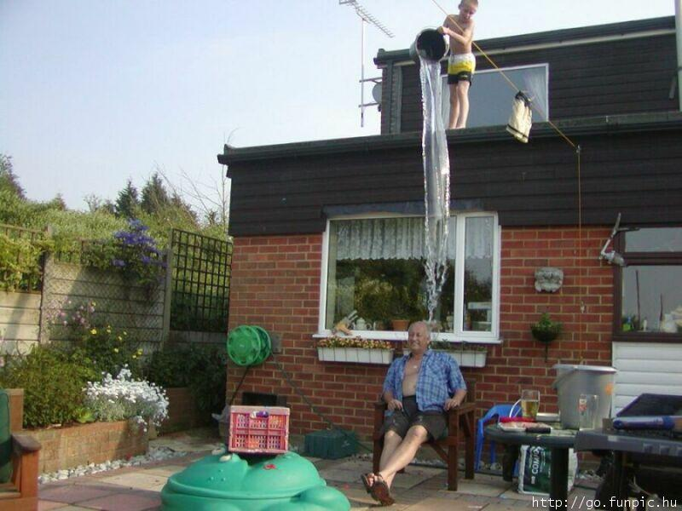

Slide 12
Child Effects
Longitudinal studies show child ADHD symptoms lead to parenting difficulties
Manipulating child medication status changes parenting behavior
Manipulating the presence of child ADHD behavior affects parent functioning
(e.g., Barkley & Cunningham, 1979; Burke et al., 2007)
e.g., Barkley & Cunningham, 1979; Burke, Pardini, & Loeber, 2008; Pelham et al., 1989

Slide 13
Effects of interacting with Children with ADHD vs. Typical Behavior: Parent Self-Report
(Pelham et al., 1997)

Slide 14
Effects of interacting with Children with ADHD vs. Typical Behavior: Parent Alcohol Consumption

Slide 15
Child Effects

Slide 16
Child ADHD
-
-
Parent-Child
Interactions
-
-
Development of Child and Family Over Time

Slide 17
Parent Effects
Approximately 65% of children with ADHD also have disruptive behavior (oppositional defiant or conduct disorder)
Parenting, and other family difficulties, causally linked to these comorbid problems
(e.g., Johnston 2015; Johnston & Chronis-Tuscano, 2015)

Slide 19
Parent Effects: Parenting Behavior
Parenting interventions improve child disruptive behavior (and ADHD?)
Longitudinally, parenting difficulties predict child disruptive behavior (and ADHD?)
Child genetic risks interact with parenting as determinants of both child disruptive behavior and ADHD
(e.g., Biederman et al., 2001; Chronis et al., 2007; Harvey et al., 2011; Li & Lee, 2013; Martel et al., 2011; Martel et al., 2012; Molina et al., 2012; Nikolas et al., 2012; Sonuga-Barke et al., 2009; Walther et al., 2012 )

Slide 20
Biological and Rearing Mother Influences on Child ADHD Symptoms
Biological Mother ADHD
Rearing Mother Hostile Parenting
.17**
.28***
.17*
Child ADHD
Child ADHD
.23***
----------------------4.5 years----------------------------------6 years----------------
(Harold et al., 2014)

Slide 21
Parent Effects: Attributions
Why did he do that?

Slide 22
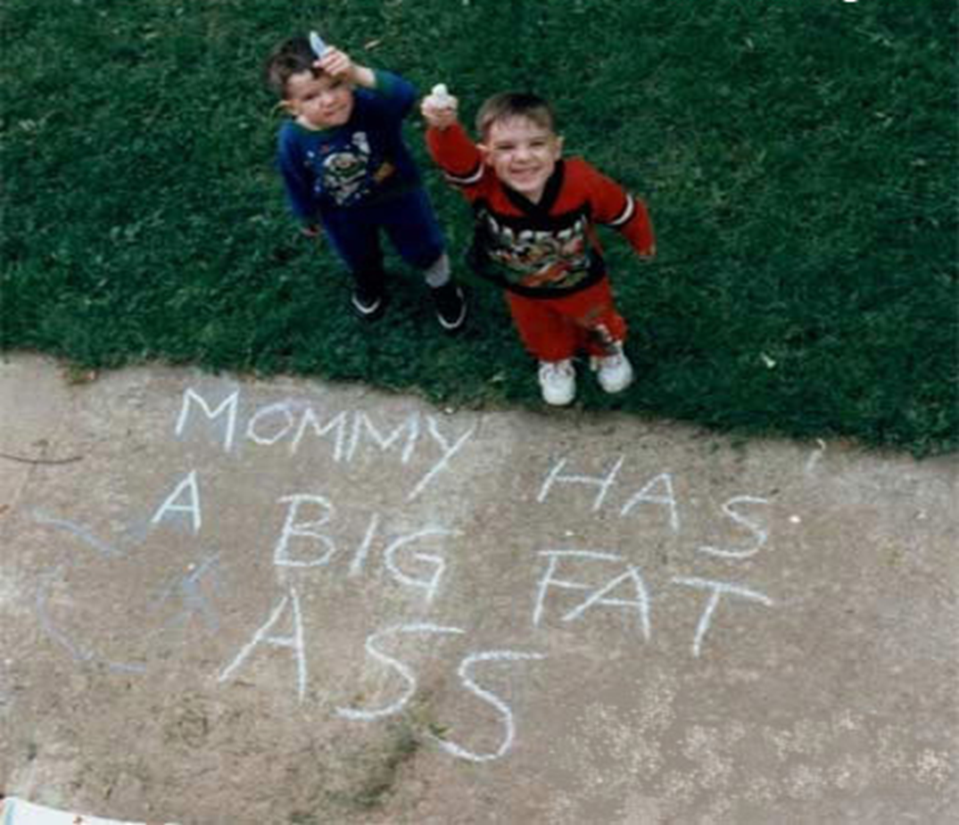

Slide 23
Parent Effects: Attributions
Parents of children with disruptive behavior more likely to blame children for misbehaviour
These child-blaming attributions lead to more negative parenting
(E.g., Johnston & Ohan, 2005)

Slide 24
Child-Blaming Attributions in Families of Control Children, Children with ADHD, and Children with ADHD and ODD Behavior
(Johnston et al., 2006)

Slide 25
Parent Effects: Attributions Predicting Child ODD Behavior 1 Year later
Child ADHD and ODD | R² = .48, p < .001
Mother Over-reactivity, Unresponsiveness | R^{2chg} = .07, p = .002
Child-Blaming Attributions | R^{2chg} = .04, p = .04
(Johnston et al., 2009)

Slide 26
Parent Effects

Slide 27
Families and ADHD
Model of parent-child interactions in families with ADHD
Child ADHD effects on parents
Parent effects on child ADHD
Parent ADHD
Ineffective control vs. positive parenting
Summary and Next Steps

Slide 28
ADHD in Families
Continuity over development
50 to 75% of children with ADHD continue to have the disorder in adulthood
Approx 50% of adults with ADHD have children with the disorder
Approx 50% of children with ADHD have a parent with high levels of symptoms
(e.g., Biederman,et al., 1995; Chang et al., 2013)

Slide 29
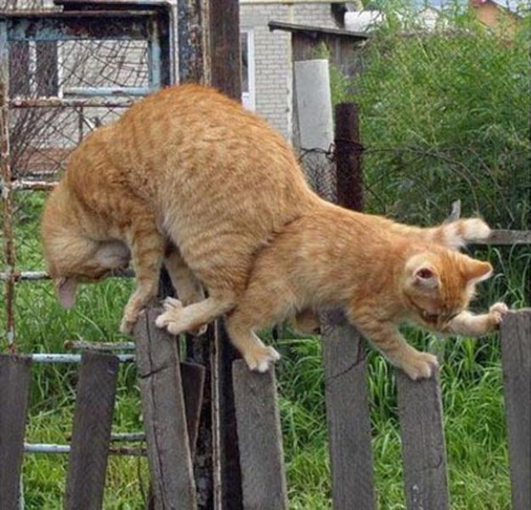

Slide 30
Mothers with and without ADHD:
Ineffective Parenting Control
(Murray & Johnston, 2006)

Slide 31
Mothers with and without ADHD:
Ineffective Parenting Control
(Murray & Johnston, 2006)

Slide 32
Predicting Ineffective Parenting Control from Mothers’ ADHD Symptoms
 | Inconsistent Discipline
Controls (child problems, maternal hostility and depression)
Maternal Inattention | B = .45, p < .001
Maternal Impulsivity | ns
(Chen & Johnston, 2008)

Slide 33
Parental ADHD and Ineffective Parenting Control
Parental ADHD symptoms linked to:
inadequate monitoring
poor problem-solving
inconsistent parenting
(E.g., Chronis-Tuscano et al., 2008; Mokrova et al., 2010; Park et al., 2017)

Slide 35
Parental ADHD Symptoms: Links to Ineffective Parental Control
179 two-parent families
approx. 75% had children with ADHD
Boys 5 to 13 years (average 9 years)
Parents approximately 40 years of age
Middle to upper middle class
Predominantly European/North American (62%) and Asian (28%)
(Johnston et al., in press; Williamson et al., 2017)

Slide 36
Parental ADHD Symptoms: Links to Ineffective Parental Control
Parents and children completed questionnaires assessing parenting
Each parent interacted with child, parenting behavior coded
Child ADHD assessed using parent and teacher reports
Parent ADHD assessed dimensionally

Slide 37
Parental ADHD Symptoms: Links to Ineffective Parental Control
Formed four groups of families:
Both mother and father above median on ADHD symptoms (Both High)
Mother above median, but father below median on ADHD symptoms (Mother High)
Father above median, but mother below median on ADHD symptoms (Father High)
Both mother and father below median on ADHD symptoms (Both Low)

Slide 38
Mother ADHD: Ineffective Parenting

Slide 39
Mother and Father ADHD: Ineffective Parenting

Slide 41
Parental ADHD and Positive Parenting
Less consistent links between parental ADHD (particularly hyperactivity/impulsivity) and emotional responsiveness or positive parenting
Some studies find NO ASSOCIATION
(e.g., Chronis-Tuscano et al., 2008; Lui et al., 2013; Murray & Johnston, 2007)

Slide 42
Mother and Father ADHD: Positive Parenting

Slide 43
Parental ADHD and Positive Parenting
Other studies find negative correlations, but only for fathers
Yet others find POSITIVE correlations, but only for mothers
(e.g., Chronis-Tuscano et al., 2008; Ellis & Nigg, 2009; Psychogiou et al., 2007)

Slide 44
Parental ADHD and Positive Parenting
Is the positive association due
to a similarity fit?
(e.g., Psychogiou, 2008)

Slide 45
Parental ADHD and Positive Parenting
We tested in same sample
Examined interactions of child diagnosis and parent ADHD symptoms (each dimension)

Slide 46
Do Parents with More ADHD have More Empathy for Children with ADHD?

Slide 47
Do Parents with More ADHD have More Empathy for Children with ADHD?

Slide 48
Do Parents with More ADHD have More Empathy for Children with ADHD?

Slide 50
Families and ADHD
Overview of ADHD
Lifespan perspective
Model of parent-child interactions in families with ADHD
Child ADHD effects on parents
Parent effects on child ADHD
Child comorbidities
Parent ADHD
Positive vs. negative parenting
Summary and Next Steps

Slide 51
Take Home Messages
Children with ADHD affect parenting
Parenting affects child outcomes
Parental ADHD important
Difficulties with parenting control
Family level effects
Possible protection against child ADHD effects on positive parenting

Slide 52
Future Directions
Child gene X Parent gene X Parenting associations
Effects of Maternal vs. Parental ADHD
Co-parenting
Treatment modifications

Slide 53
Thank you!

